Slide 1
RC/Automated Grass Cutter
Mentors :
Prof. Alcides alvear,
Prof. Diego a. Aponte,
dr. Miguel goenaga
Jose A. Ortiz (computer engineer)
Juan E. Rivera (electrical engineer)
Victor E. Castro (electrical engineer)

Slide 2
Problems Statement
Mowing the lawn is an exhausting job.
People with disabilities are not able to do it.
Pay for doing it is expensive in long term.
Reduce emissions and gasoline spills
José Ortiz, Juan Rivera & Victor Castro
Notes:
uohjiyghijuohi

Slide 3
Solution
Create a machine that helps people mowing the grass in a simple way. This machine will be controlled through a mobile device using an application via Bluetooth or Wi-Fi . The user will also have the option to use it in autonomous mode.
José Ortiz, Juan Rivera & Victor Castro

Slide 4
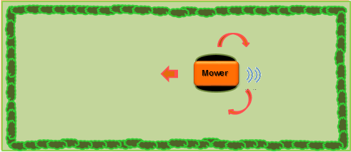
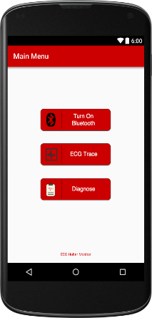
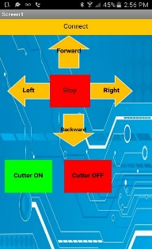
Concept
Our design is a remote control lawn mower that can be control through a cellular phone via Bluetooth.
José Ortiz, Juan Rivera & Victor Castro

Slide 5
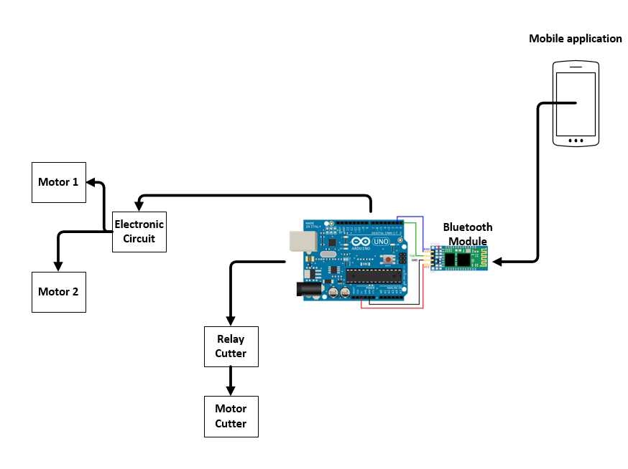
Block Diagram

Slide 6
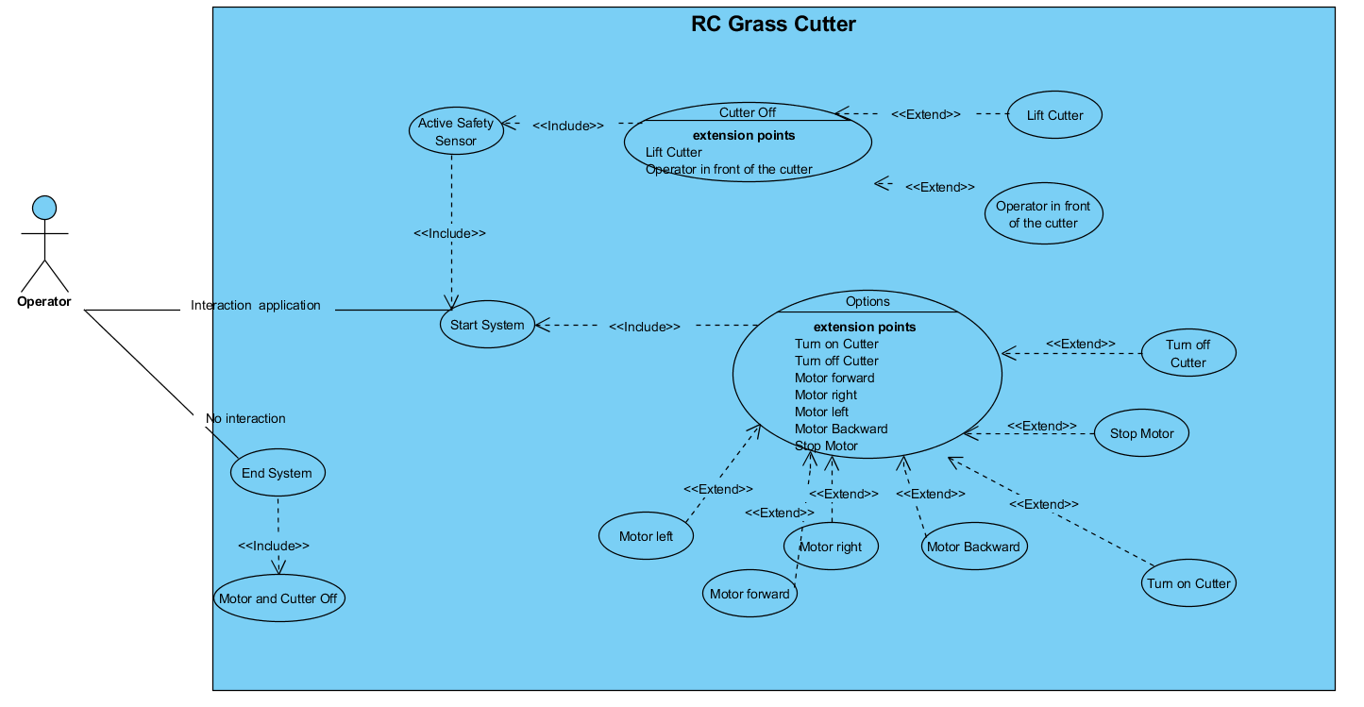

Use Case Diagram

Slide 7
Requirement
Functional
Cut the grass remotely or autonomous mode.
A microcontroller to send signals to the H-Bridge to control the direction of the grass cutter.
Communication with phone application.
Non - Functional
Development application in IOS
Sensors for safety
Charging Station
Power line communication
José Ortiz, Juan Rivera & Victor Castro

Slide 8
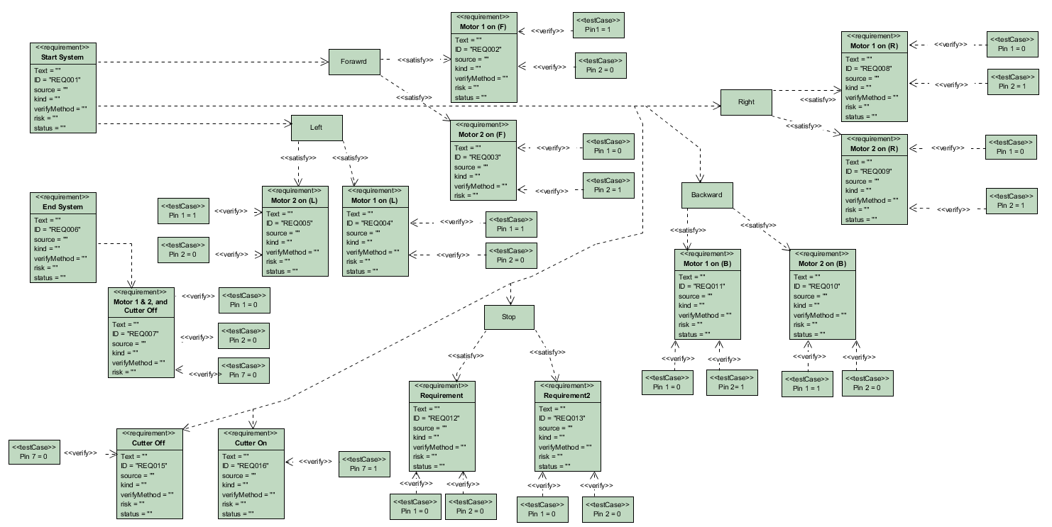
Requirement Diagram

Slide 9
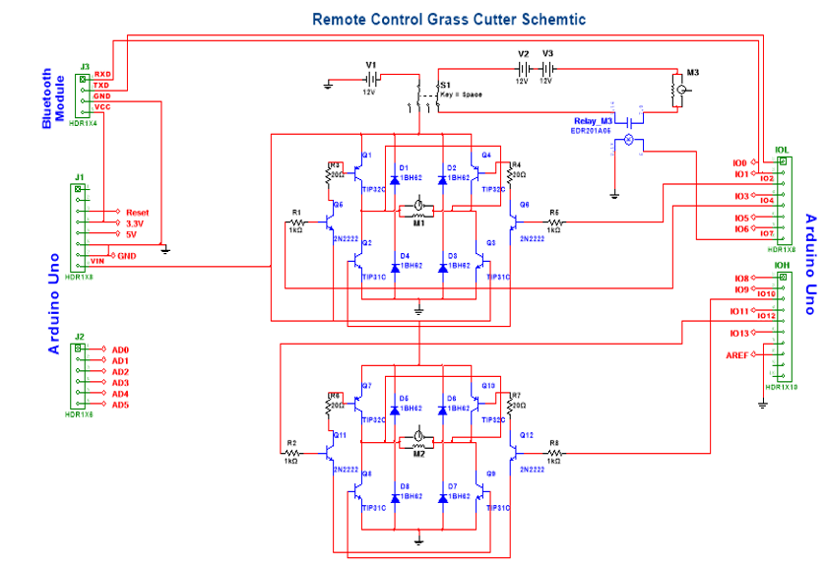
Grass Cutter Circuit
José Ortiz, Juan Rivera & Victor Castro

Slide 10
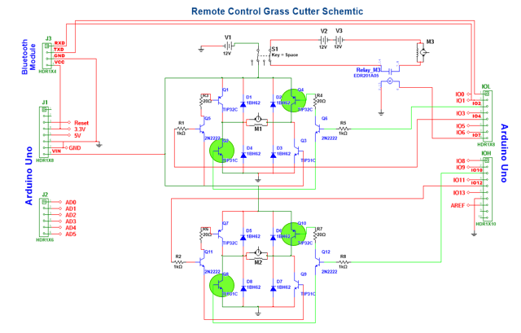
José Ortiz, Juan Rivera & Victor Castro

Slide 11
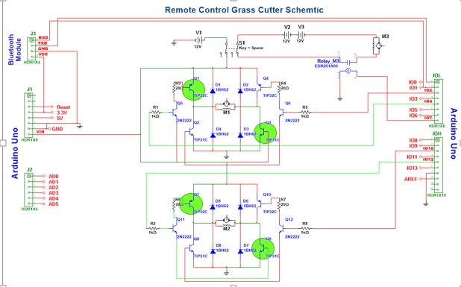
José Ortiz, Juan Rivera & Victor Castro

Slide 12
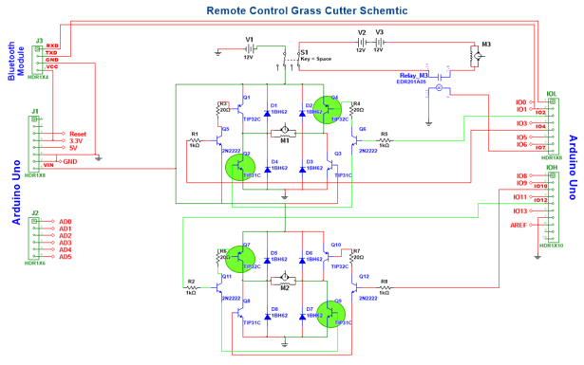
José Ortiz, Juan Rivera & Victor Castro

Slide 13
Methodology: Scrum
It allows us at any time to realign the software with the objectives of the business or project, since it can introduce functional or priority changes at the beginning of each new iteration without any problem.
Flexibility to change
Reduction of the Time to Market
José Ortiz, Juan Rivera & Victor Castro

Slide 14
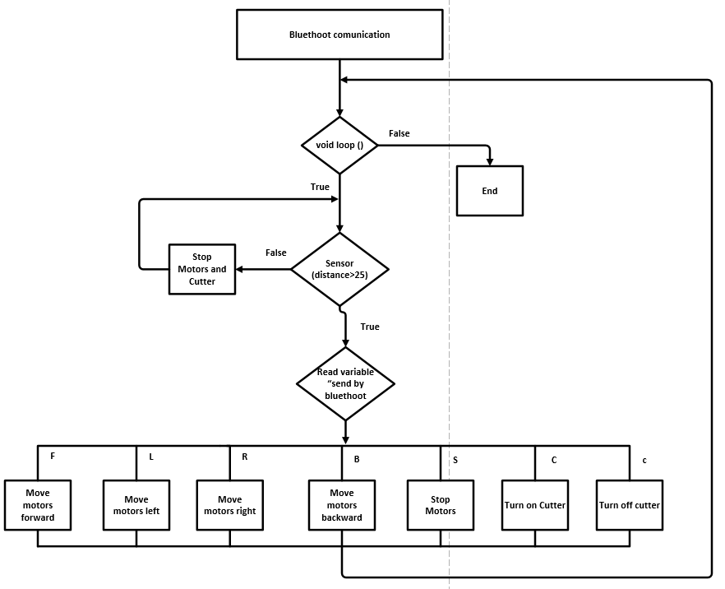
Design of the System: Flowchart
José Ortiz, Juan Rivera & Victor Castro

Slide 15
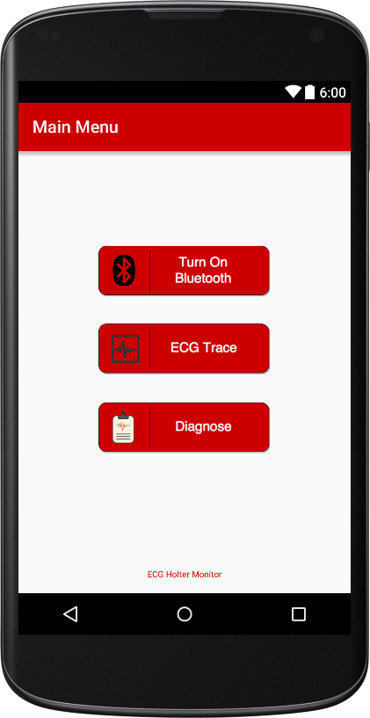

Android application (Prototype)
José Ortiz, Juan Rivera & Victor Castro

Slide 16
Estimate Material Cost
Estimated Material Cost
Materials | Amount | Sub-Total
Arduino Uno | 1 | $ 5.00
Diode | 8 | $ 4.00
Transistors | 12 | $ 16.00
Relay | 1 | $ 3.00
Resistor | 12 | $ 1.20
Batteries 12V | 3 | $ 75.00
Motor 12V | 2 | $ 50.00
Motor 24V | 1 | $ 20.00
Soldering Board | 1 | $ 2.50
Switch | 1 | $ 2.00
Bluetooth Module | 1 | $ 2.75
Total |  | $ 181.45

Slide 17
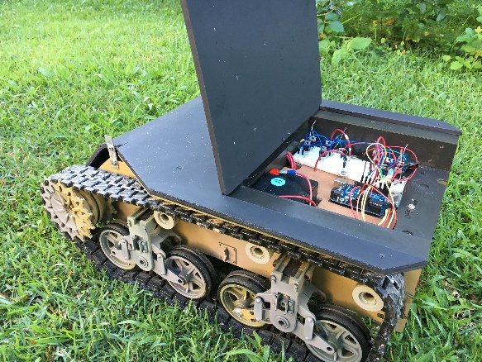
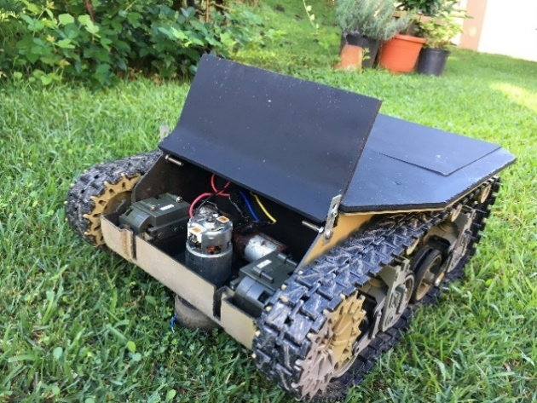
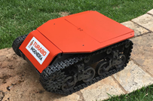
RC Grass Cutter (Prototype)
José Ortiz, Juan Rivera & Victor Castro

Slide 18
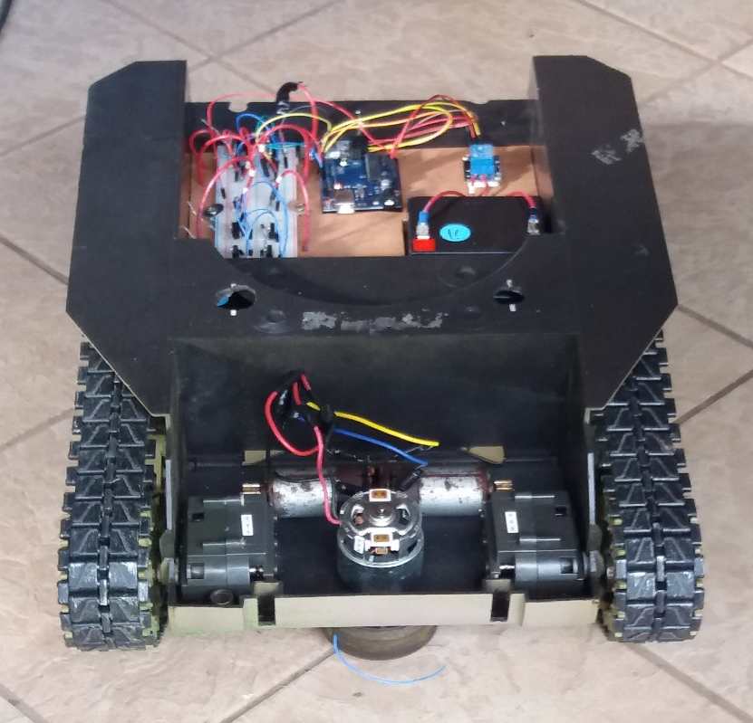
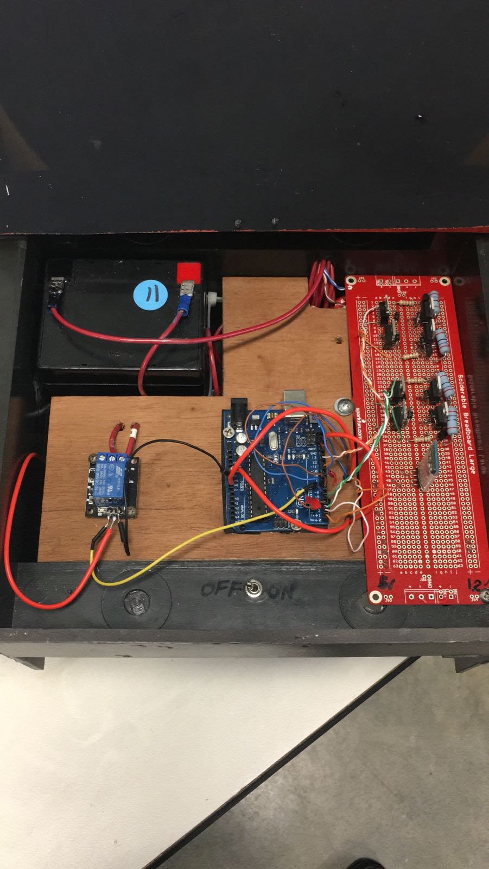
Before
Now
José Ortiz, Juan Rivera & Victor Castro

Slide 19
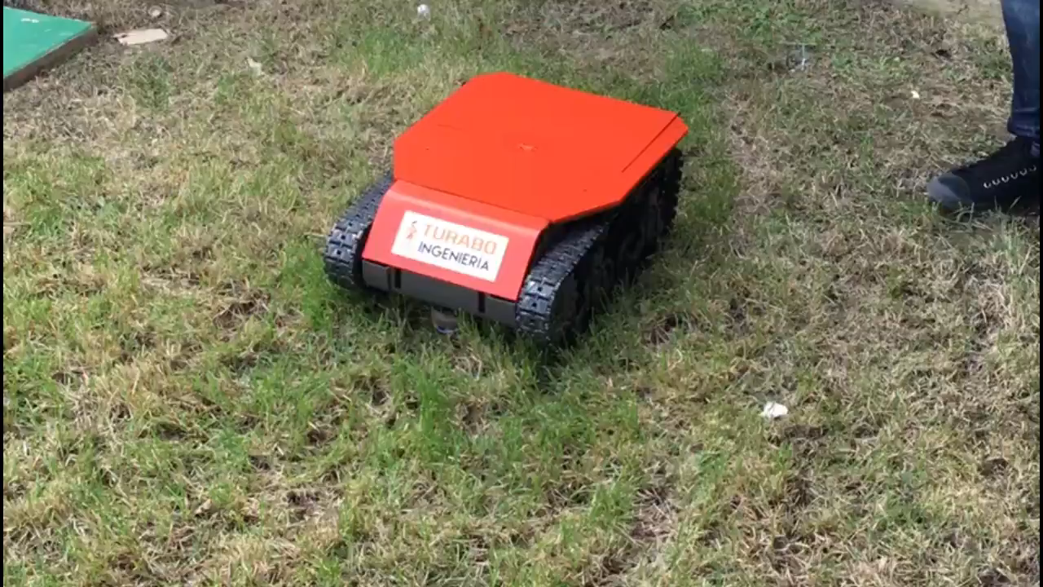

Slide 20
Future Work
Implementation of autonomous capability.
Safety features capabilities.
Change propulsion motors to 24V
Create a charging station.
Improve the mobile device application.
Develop an IOS application.

Slide 21
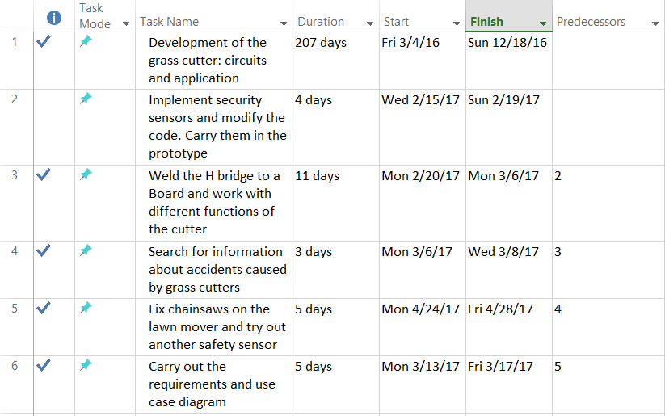

Gantt Chart
José Ortiz, Juan Rivera & Victor Castro

Slide 22
References
Boylestad, R., & Nashelsky, L. (2009). Electronic Devices and Circuit Theory (10th Ed.), Columbus, OH, Prentice Hall.
Cubie, D. (2007, 08 01). How to Mow Down Pollution. Retrieved from nwf.org: https://www.nwf.org/News-and-Magazines/National-Wildlife/Gardening/Archives/2007/How-to-Mow-Down-Pollution.aspx
Lawn mower accident cause needless amputation. (2015). Retrieved from amputee-coalition.og: http://www.amputee-coalition.org/lawn-mower-accidents-cause-needless-amputations/
Mclaren, W. (2012, September 28). The grass can be greener. Retrieved from abc.net: www.abc.net/environment/articles/2012/09/28/3599373.htm
Sadaka, S. (2014). LAwn Mower Safety. Retrieved from uaex.edu: https://www.uaex.edu/publications/PDF/FSA-1005.pdf
Sedra, A., & Smith, K. (2015). Microelectronic Circuits (10th Ed.), New York, NY, Oxford University Press.

Slide 23
Questions ?
José Ortiz, Juan Rivera & Victor Castro

